Slide 1
TABLEAU INTRODUCTION.

Slide 2

AGENDA.
Introduction.
Chart Type & Dashboard Flow.
Data Connection.
First Charts.
Further Resources.

Slide 3


WHY TABLEAU
Here's the story...
Suppose you are an employee for a large retail chain. Your manager just got the quarterly sales report, and noticed that sales seem better for some products than for others and profit in some areas is not doing as well as she had expected. Your boss is interested in the bottom line: It's your job to look at overall sales and profitability to see if you can find out what's driving these numbers.

Slide 4
WHAT IS TABLEAU
Tableau is a data visualization and business intelligence software that helps people see and understand their data.
It allows users to connect to various data sources, create interactive visualizations, and share them with others.
It is used by organizations of all sizes to gain insights from their data and make data-driven decisions.
Notes:
Full Page Image w Color Bar

Slide 5
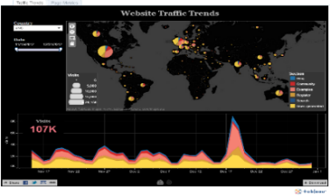
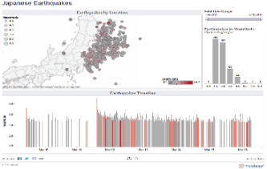
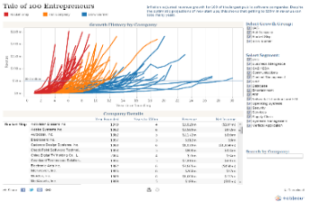
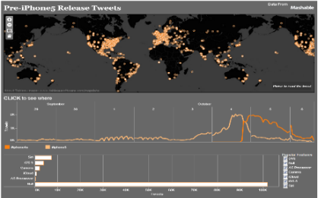
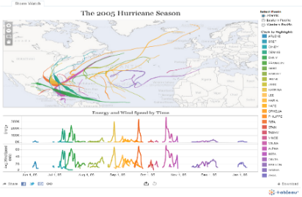
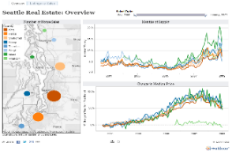
WHAT QUESTION ARE YOU TRYING TO ANSWER?

Slide 6
CHART TYPES.

Slide 7
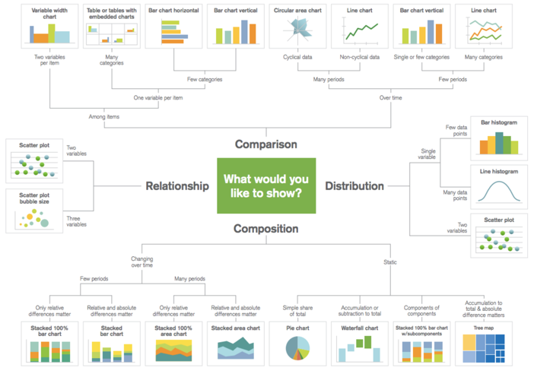
DO I HAVE THE RIGHT CHART?

Slide 8
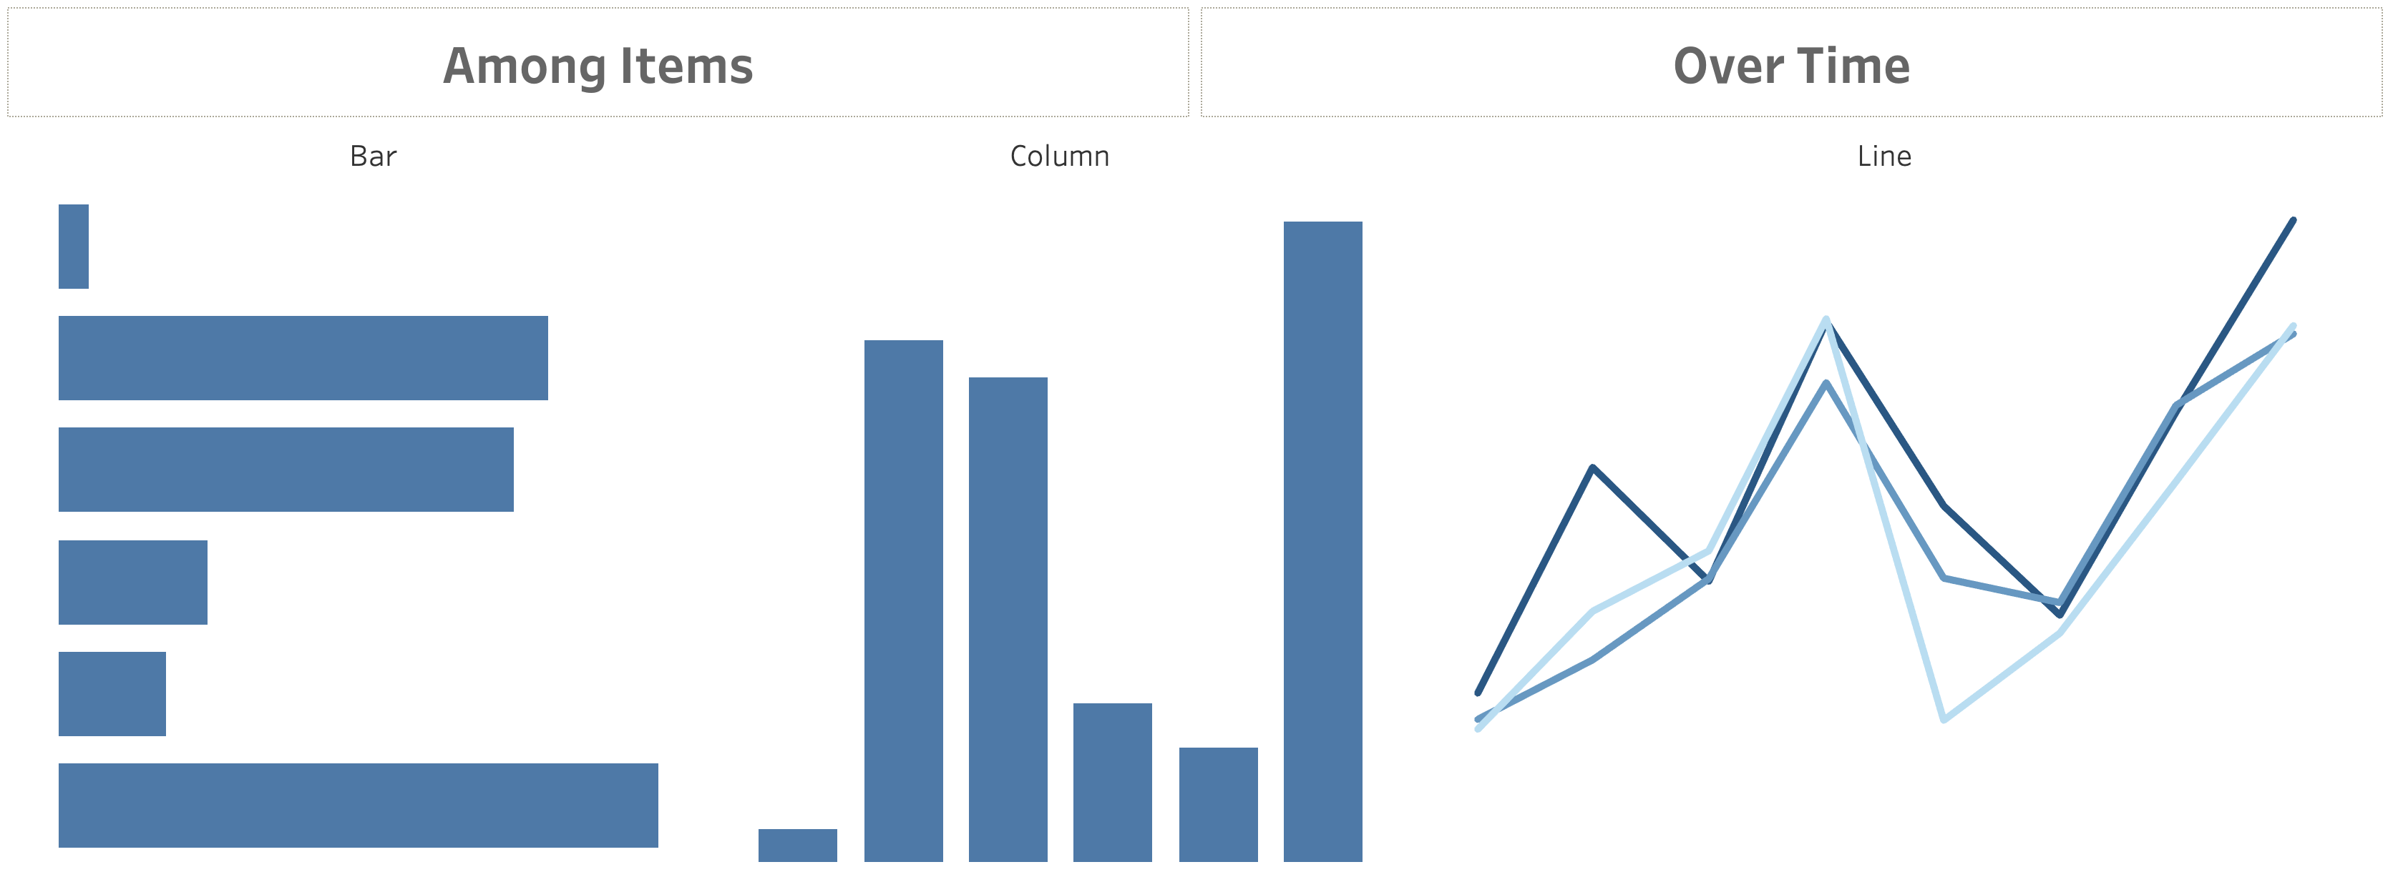
COMPARISON.

Slide 9
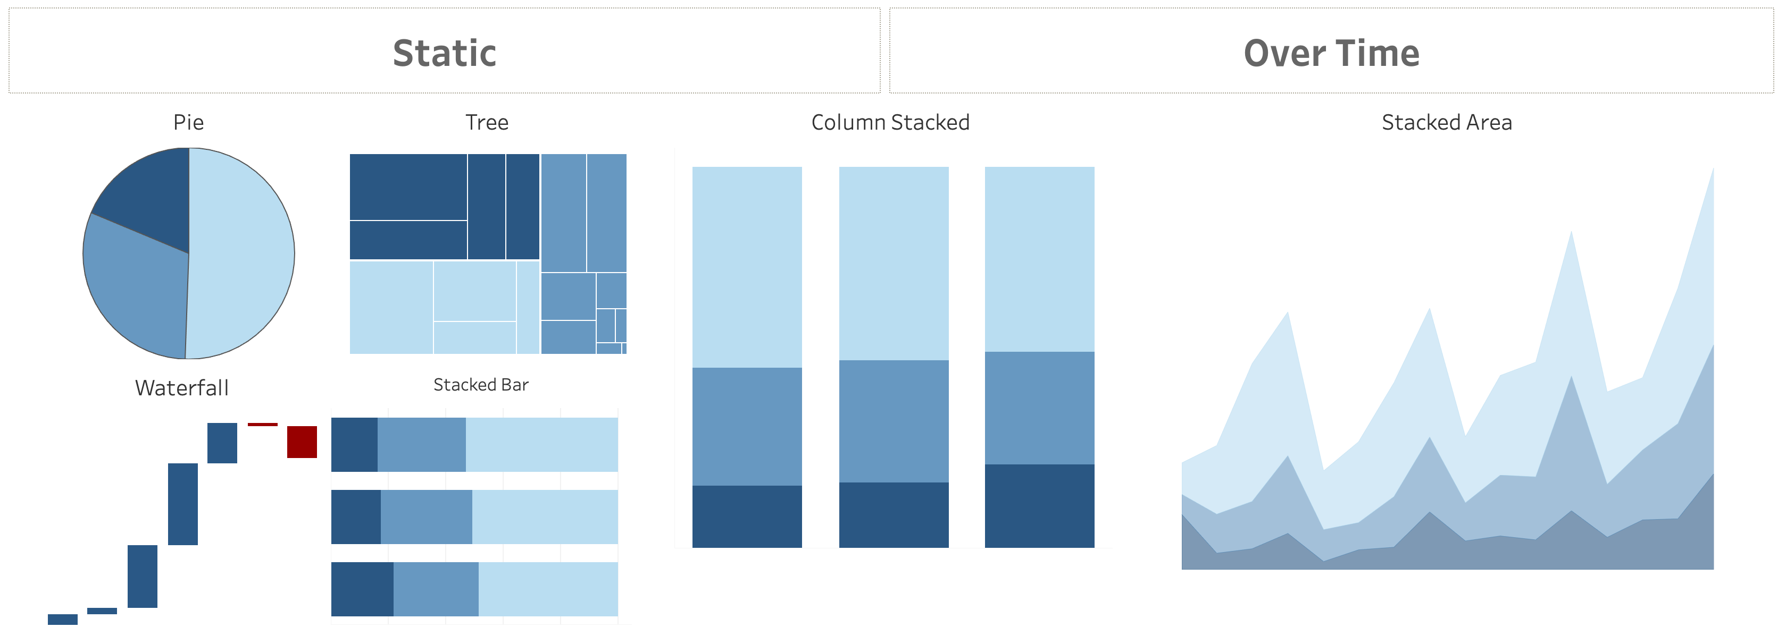
COMPOSITION.

Slide 10
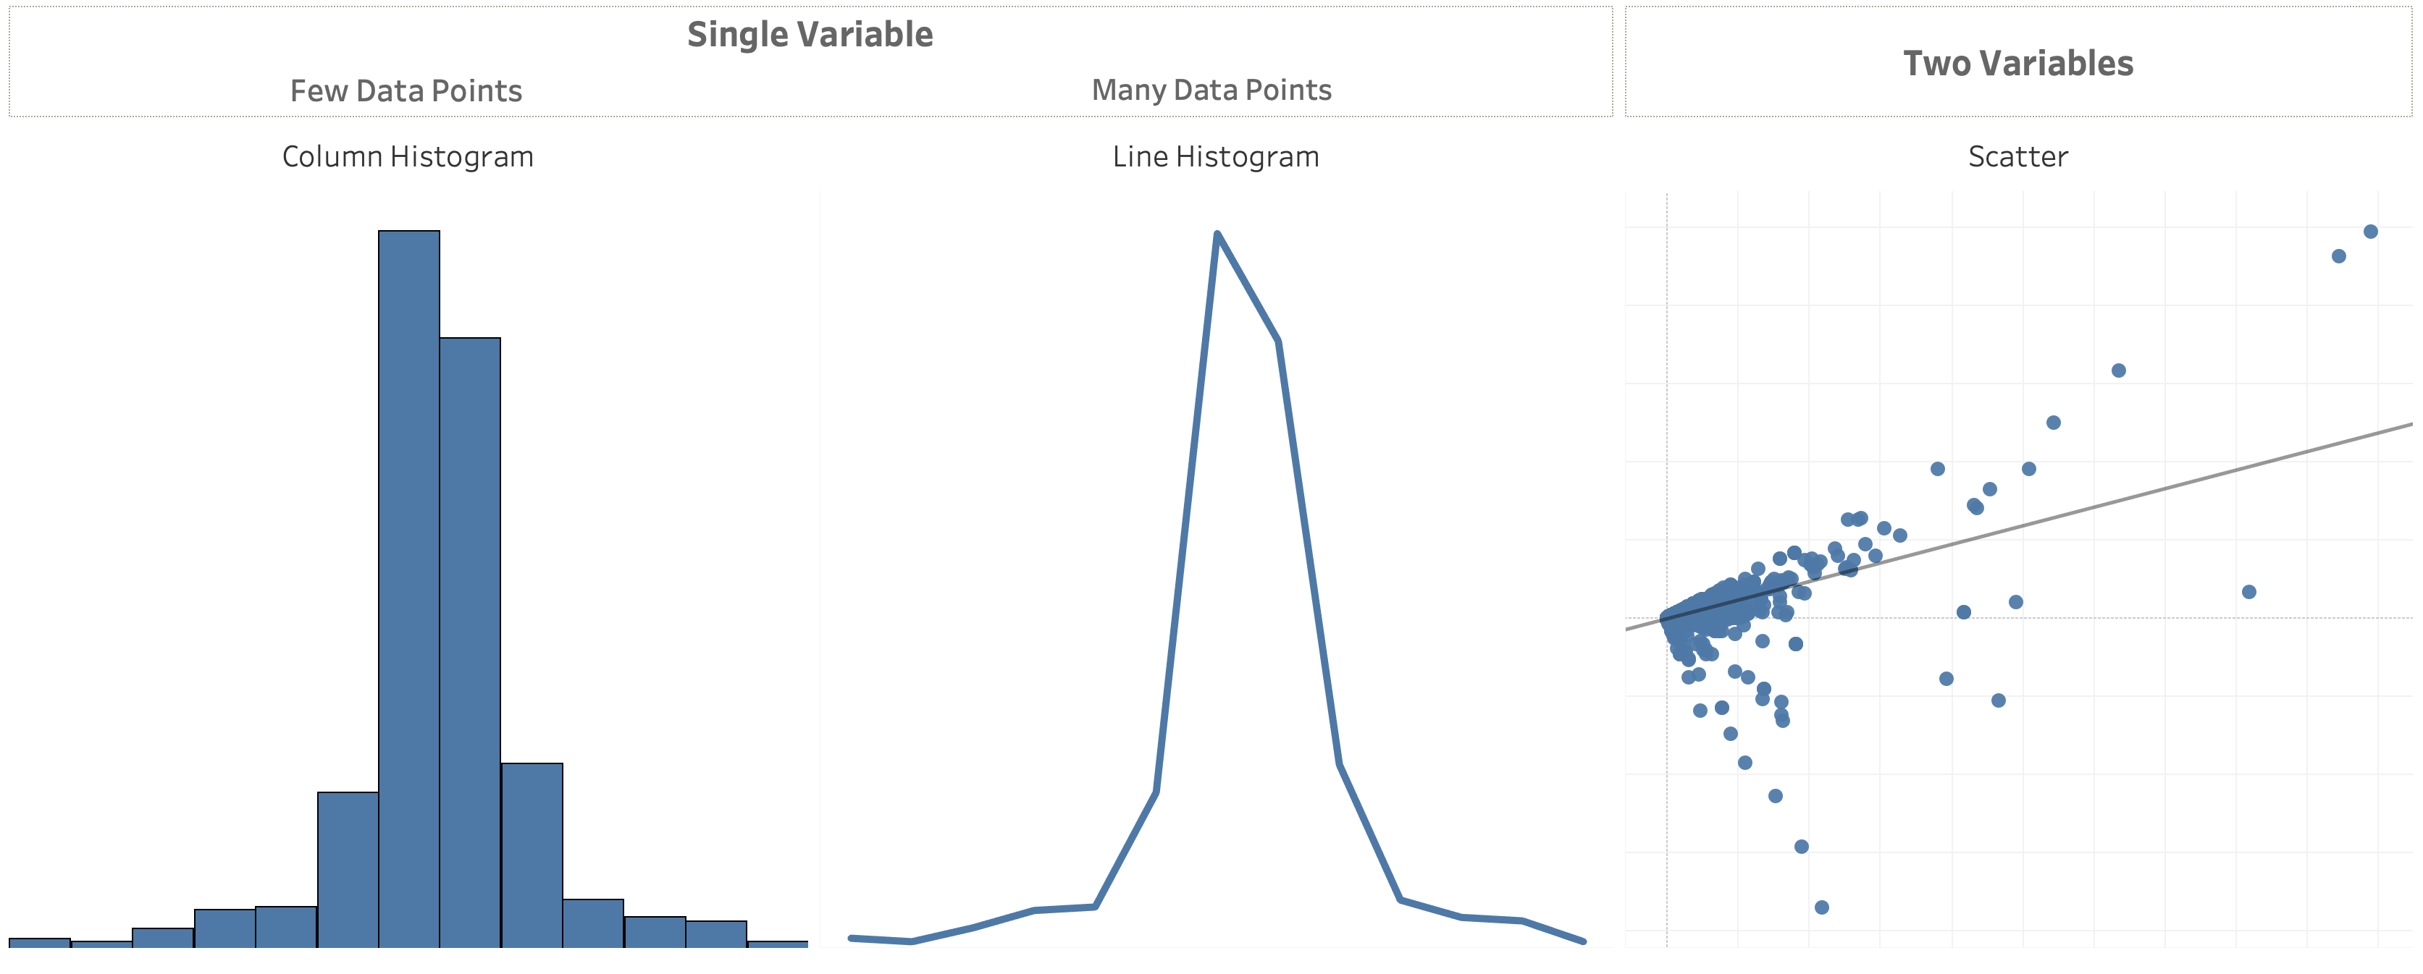
DISTRIBUTION.

Slide 11
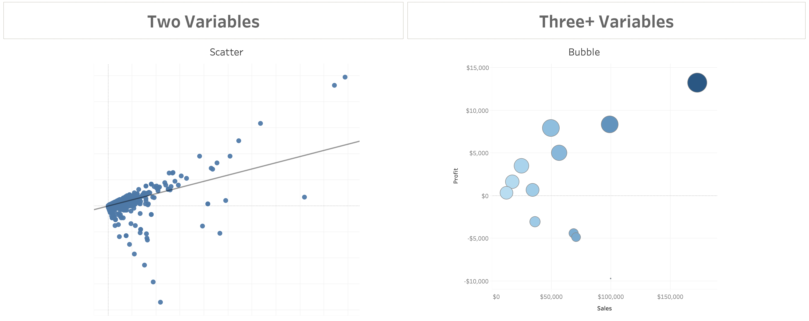
RELATIONSHIP.

Slide 12

Notes:
In this exercise we are going to take 3 seconds to try and identify which month has the highest number of sales for the year….
Are we ready?
Make it easier… Click

Slide 13
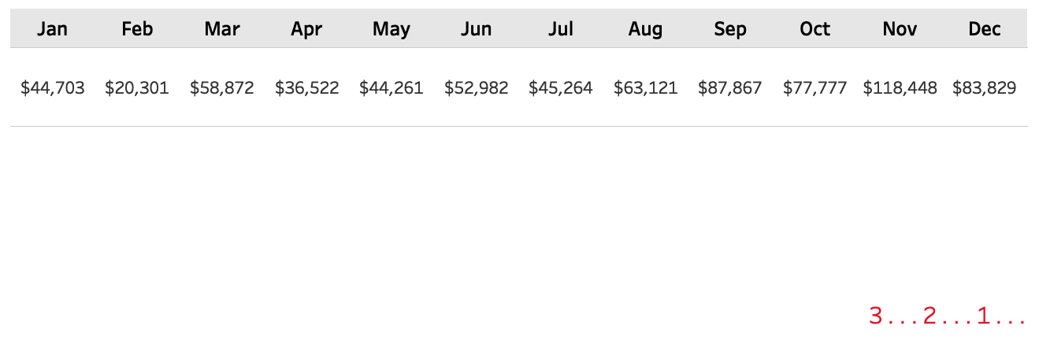

Slide 14

Notes:
Who can tell me which month had the highest number of sales?

Slide 15
Notes:
We are going to do this again but this time I want you to not just find one but the Top three performing months.
Are we ready?

Slide 16
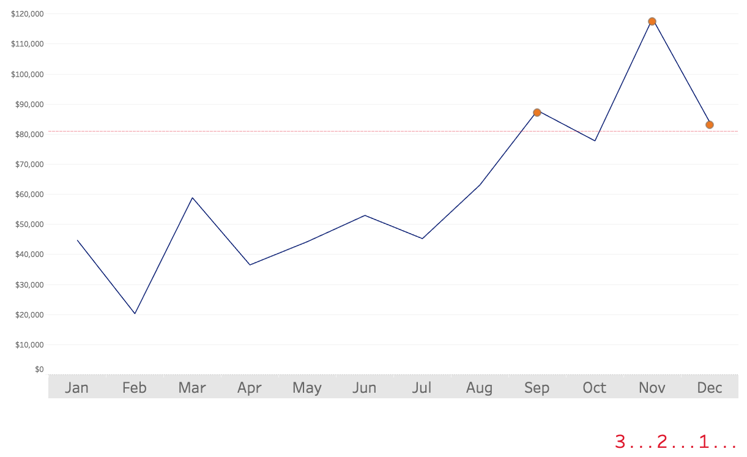

Slide 17

Notes:
How many of you were able to identify the top 3 performing months?

Slide 18
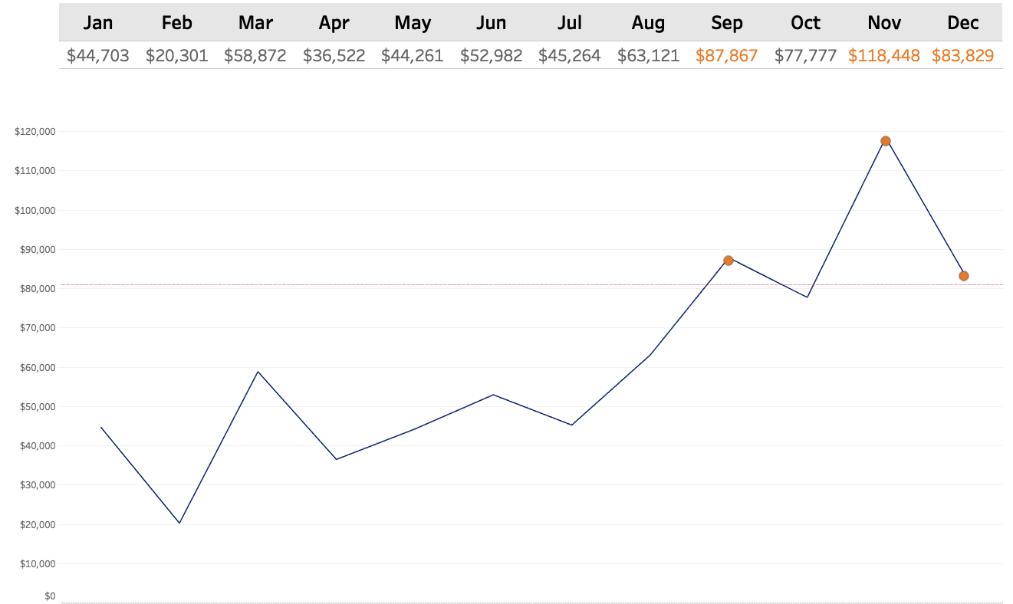
Notes:
So by visualizing the data and incorporating a few key pre-attentive attributes (like shape and color) I was able to effectively draw your eyes to the key places on the page where I wanted you to look.
Not only were you able to quickly identify data points of importance, you were also able to draw many other conclusions like: sales are steadily climbing, last 1/2 of the year out performed the first half.
The reason why we visualize data is so we can communicate information faster and make is easier to understand.

Slide 19
TITLE.

Slide 20
A concise, descriptive title can make a huge difference in garnering attention and making a chart more memorable

Slide 21
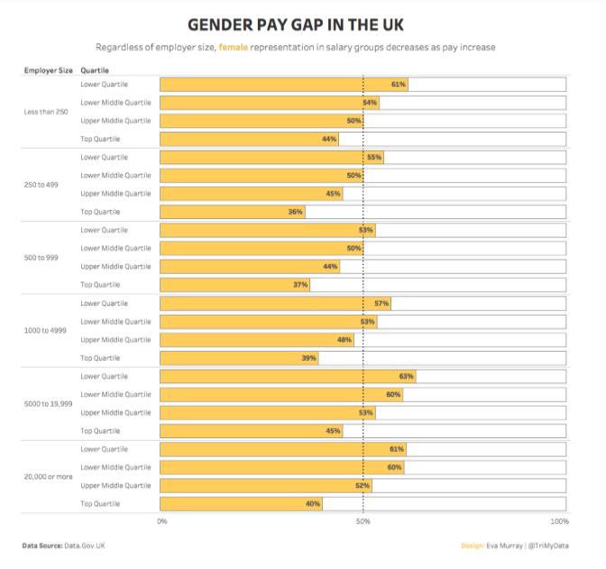
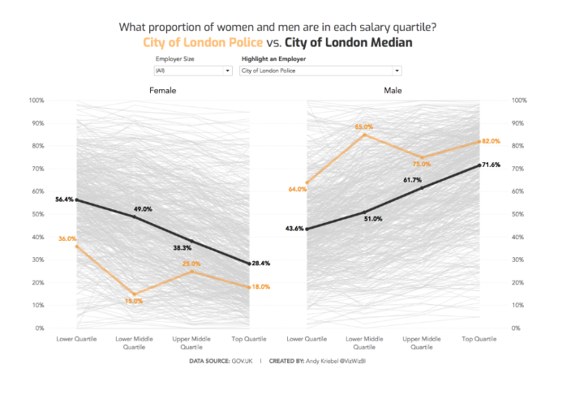
WHICH TITLE IS MORE IMPACTFUL?

Slide 22
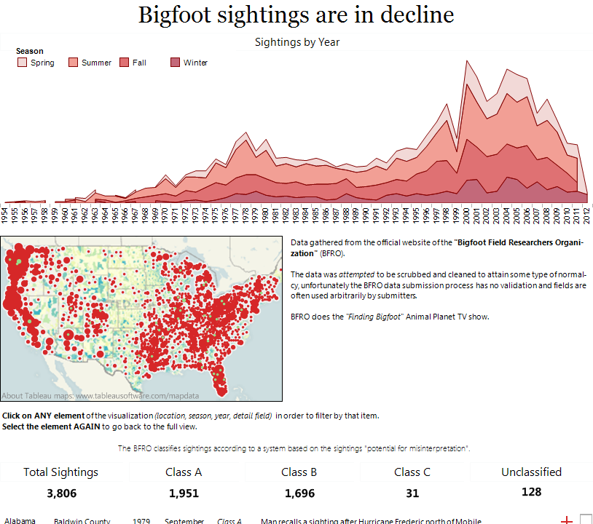
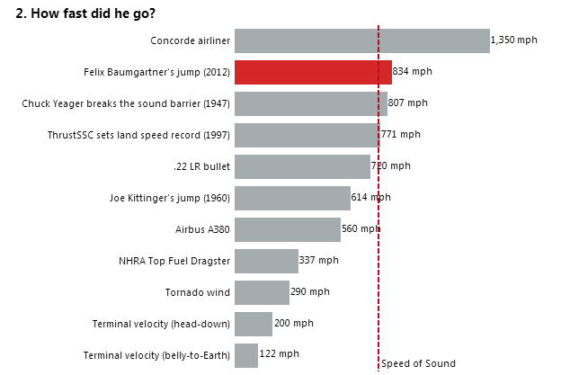
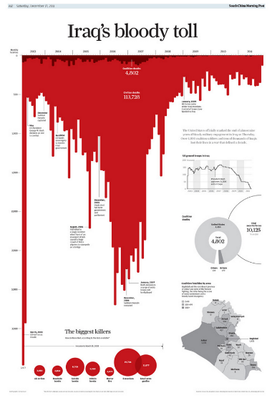
DO YOUR TITLES CAPTURE ATTENTION?

Slide 23
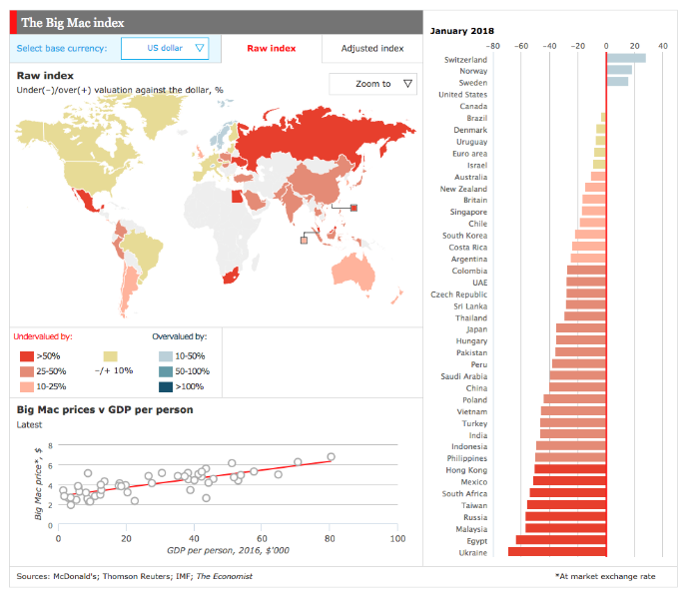
CONTEXT IS NOT JUST IN THE TITLE

Slide 24
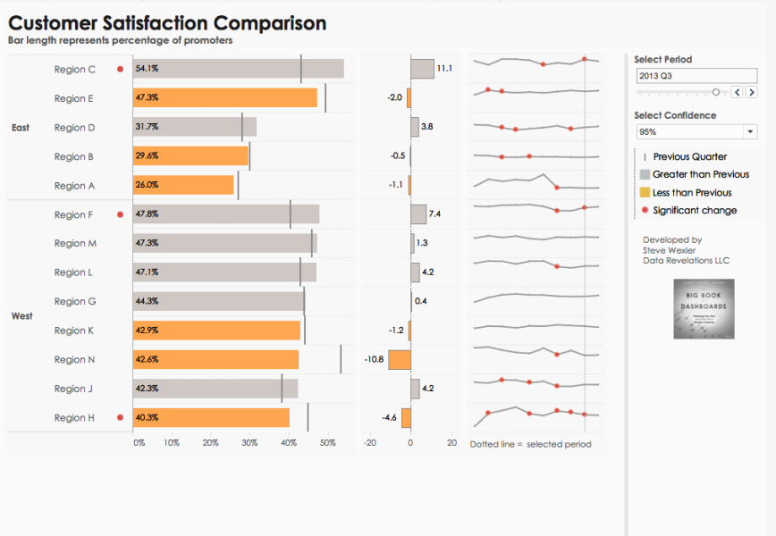
ADDING ADDITIONAL CONTEXT

Slide 25
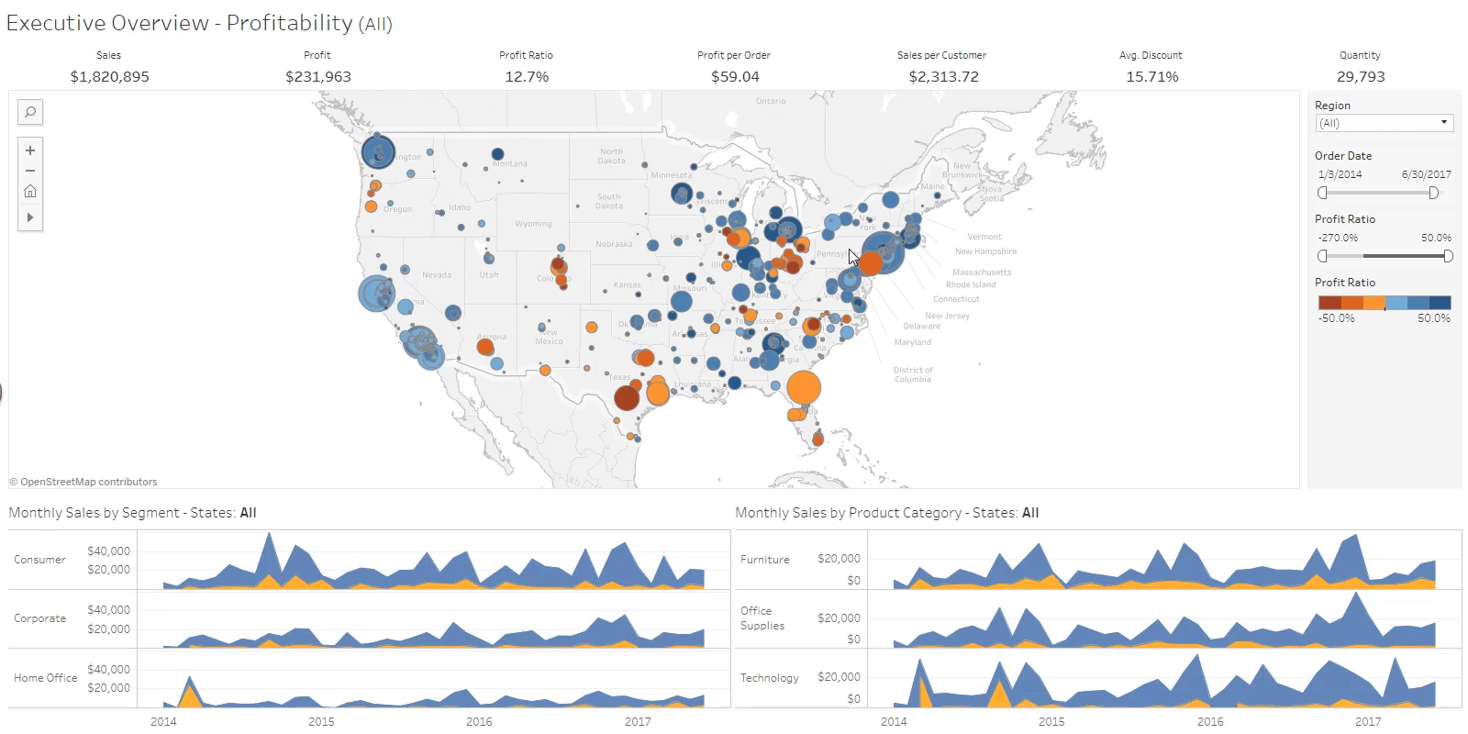

Slide 26
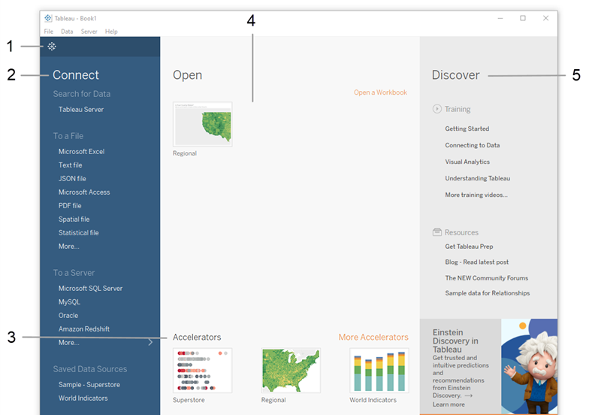
CONNECTING DATA.
Notes:
https://help.tableau.com/current/guides/get-started-tutorial/en-us/get-started-tutorial-home.htm
Let’s dig in.

